Slide 1

MALLAREDDY INSTITUTE OF ENGINEERING AND TECHNOLOGY
A mini project report on
DIGITAL INSTITUTE
Under the esteemed guidance of
Mrs. K.SAI MADHURI
Assistant Professor, CSE
Submitted By
RAJAN MANI TRIPATHI (Regd. No: 17W91A05B0)
K.SUMANTH REDDY (Regd. No: 17W91A0588)
MOHD SULTAN RAYNI (Regd. No: 17W91A0595)

Slide 2
DIGITAL INSTITUTE

Slide 3
ABSTRACT
1

Slide 4
Abstract
The main aim of this project is to create a platform where we can share videos and pdf over the network for students and institute.
Purpose of the interface is to make student research and idea’s made be private between the institute and student.
There are two features available in the application for now
Video (mp4)
Documents(Pdf)

Slide 5
EXISTING SYSTEM
2

Slide 6
Existing System
There is no one system that provides all the functionalities of our
proposed system, the current systems are:
Youtube
Google Drive
E-Library

Slide 7
PROPOSED SYSTEM
3

Slide 8
Proposed System
The proposed system is an intranet-based system that provides multiple facilities for both students and the faculty and makes tasks easier for them.
Some main features of the proposed system are:
The ability to share their idea in mp4 format.
A document sharing and management system in pdf format.
The privatize network for institute for their faculty and students.
The students can view all the documents and video of research.
Ability to think and understand and say their idea and solution on the problem in research in mp4 and pdf format.

Slide 9
Features Added
Personalize Video Stream Uploader and Viewer.
Library (All the uploaded pdf can be viewed) The privatize network for institute for their faculty and students.
Research Documents can be uploaded in pdf format.
Faculty and Students both can upload their ideas in the video format.
Institute can have all the data in firebase and helps the students and faculty in research.

Slide 10
Limitations
It’s one of the limitations is server storage.
RealTime database limitation of firebase.
Institute have to manage the firebase Server and cloud.
Only pdf and mp4 video files are used.
The processing is Institute specific.

Slide 11
Objectives
The ability to do Privatize research and idea storage.
A document sharing and management system by means of pdf.
Mobile Friendly.
User Friendly.
The ability to login and register.
The Institute can gather the data for processing and knowing the interest of student and faculty for managing their resources.
The secure private network for the institute in the most used device by faculty and student (Android Phone).
The students can view all the documents and videos of research.

Slide 12
SYSTEM REQUIREMENTS
5

Slide 13
Software And Hardware Requirements
SOFTWARE
Operating system :
Any
Programming Language : Java,XML
IDE :
Android Studio
HARDWARE
RAM : >8GB
SSD/HDD : 250GB
Processor
Intel i3 8 or more
Physical Device:
Android Phone >6.0

Slide 14
TECHNOLOGIES USED
6

Slide 15
Our process is easy
FireBase
Java
XML
Firebase Cloud Database
Firebase
Firebase
Server
Authentication
Programming language
User Interface
Database
Real Time Database

Slide 16
Libraries
7

Slide 17
androidx.appcompat:appcompat
androidx.navigation:navigation-fragment
androidx.navigation:navigation-ui
androidx.legacy:legacy-support-v4
com.google.android.exoplayer:exoplaye
com.google.android.exoplayer:exoplayer-core
com.google.android.exoplayer:exoplayer-dash
com.google.android.exoplayer:exoplayer-ui
com.google.android.exoplayer:exoplayer-smoothstreaming
com.google.android.exoplayer:exoplayer-hls
androidx.constraintlayout:constraintlayout
com.google.firebase:firebase-auth
com.firebaseui:firebase-ui-database
com.google.android.material:material
androidx.annotation:annotation
androidx.lifecycle:lifecycle-extensions
com.google.firebase:firebase-database
com.google.firebase:firebase-analytics
com.google.firebase:firebase-storage
de.hdodenhof:circleimageview
androidx.test.espresso:espresso-core
com.google.firebase:firebase-analytics
com.google.firebase:firebase-database

Slide 18
SCREEN SHOTS
8

Slide 19
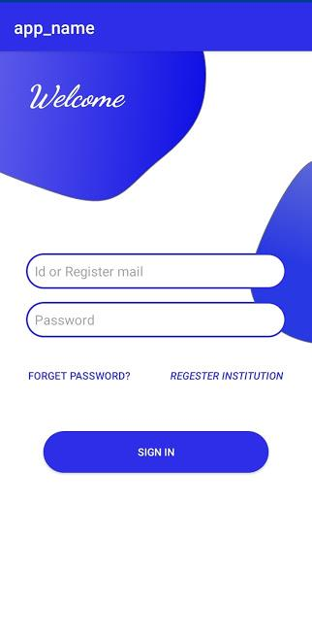
Login

Slide 20
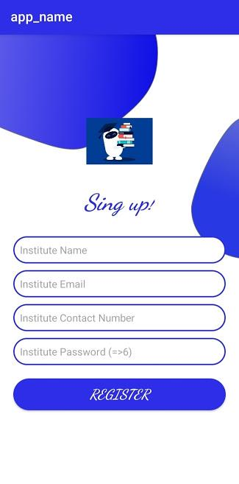
Sign Up

Slide 21
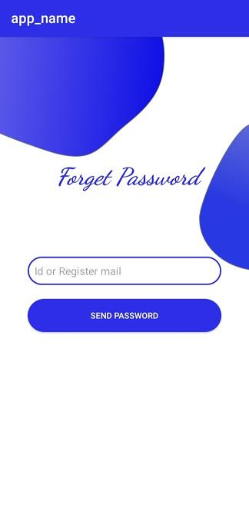
Forgot Password

Slide 22
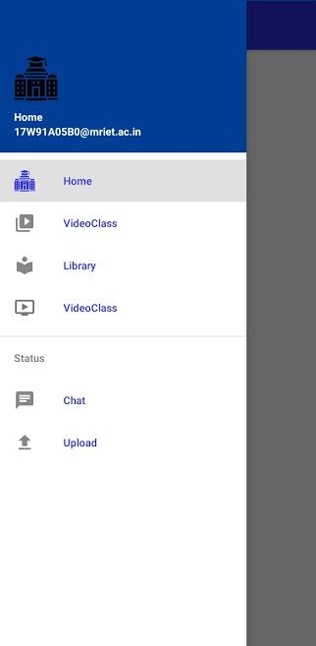
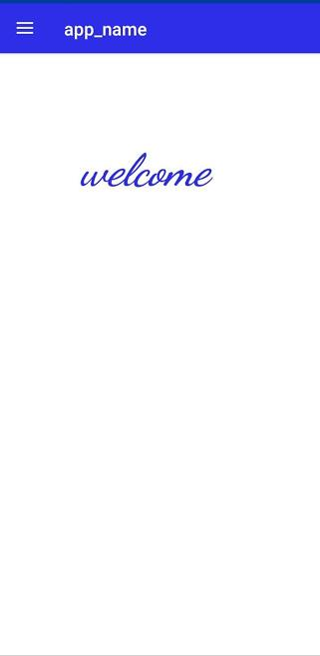
Main Menu

Slide 23
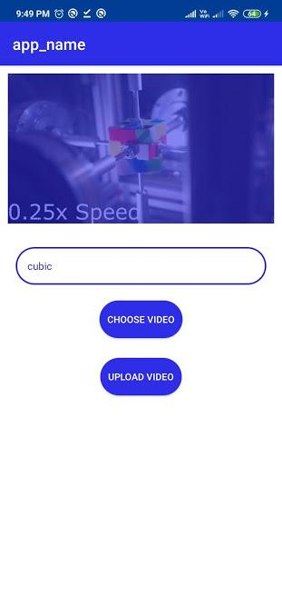
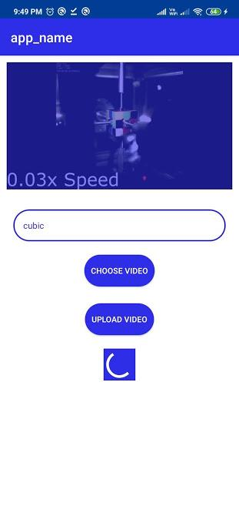
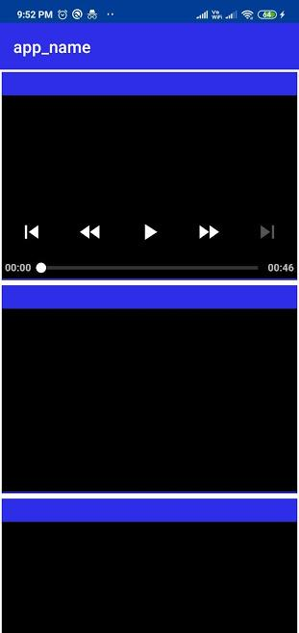
Video

Slide 24
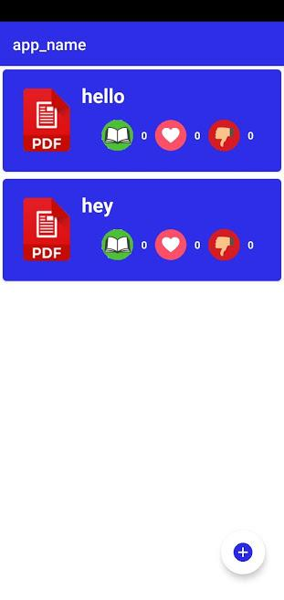
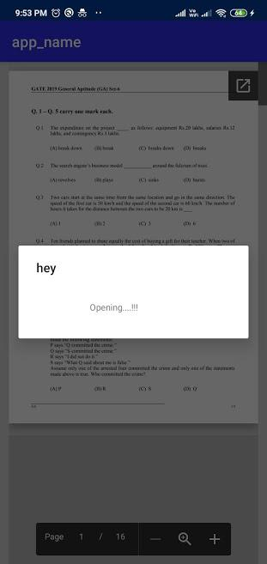
Pdf View

Slide 25
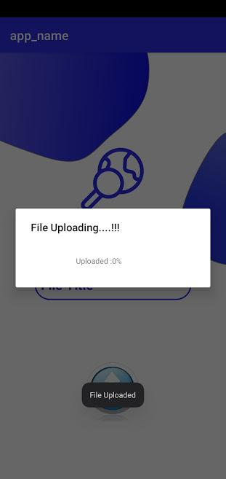
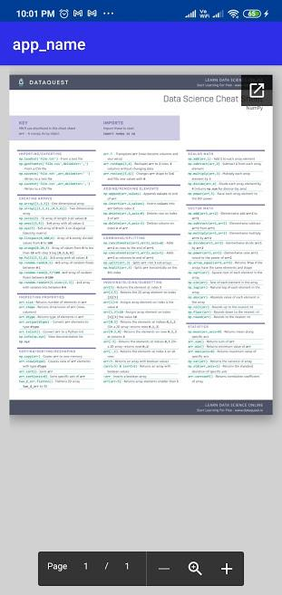
Pdf Upload

Slide 26
CONCLUSION
9

Slide 27
Conclusion
This project helps in making a private network for institute such that their faculty and students can share their thoughts and ideas by video and pdf format.
Reason of choosing mp4 and pdf is as its compatable with all kinds of android phones

Slide 28
REFERENCES
10

Slide 29
References
https://firebase.google.com/docs/
https://developer.android.com/docs/
https://docs.oracle.com/en/java/
https://devdocs.io/openjdk~11/
https://www.w3.org/TR/xml/

Slide 30
THANKS!
Any queries?

